Slide 1
Employee Attrition Analysis
Team 2: Emeline Ruvinskiy, Stephen Thomas, Joyce Zhang

Slide 2
Agenda
Business Understanding 3
Data Understanding 5
Data Preparation 9
Modeling 11
Evaluation 17
Deployment 20
Q & A 22
Appendix 23

Slide 3
Business
Understanding

Slide 4
Business Understanding
Data Understanding
Data Preparation
Modeling
Evaluation
Deployment
“Managers tend to blame their turnover problems on everything under the sun, while ignoring the crux of the matter: people don’t leave jobs; they leave managers.” —— Travis BradBerry
The Solution:
A classification, predictive model that can show which attributes employees' value that affect attrition rates and predict if an employee will leave their job or not
The Issue:
Many companies do not know why their employees leave
Employees’ satisfaction is crucial in ensuring a lasting and productive workforce
Tech companies’ greatest assets are their employees

Slide 5
Data
Understanding

Slide 6
Business Understanding
Data Understanding
Data Preparation
Modeling
Evaluation
Deployment
“IBM HR Analytics Employee Attrition & Performance”
Created by IBM Data Scientists to predict attrition rates in companies
Source: Kaggle
Summary of Data
Dataset Structure
1470 observations (rows), 35 variables, 34 attributes (independent variable)
Data Type
Only two data types: categorical and numeric
Meaning of our Data
Most features are ordinal variables. Many of them have a range from 1-4 or 1-5, the lower the ordinal variable, the worse it is in this case. For instance, Job Satisfaction 1 = “Low”, while 4 = “Very High”
Target Variable (label)
Attrition is our target variable, and we would like to find out why employees are leaving the company
Missing Data
Luckily for us, there is no missing data! This will make us easier to work with the dataset

Slide 7
Business Understanding
Data Understanding
Data Preparation
Modeling
Evaluation
Deployment
Visualization of Target Variable — Attrition
The distribution of the attrition variable is class no 84%, class yes 16%, the ratio of no/yes is 5.25:1
Class imbalance influences a learning algorithm during model fitting, we will use resampling method to obtain a balanced data

Slide 8
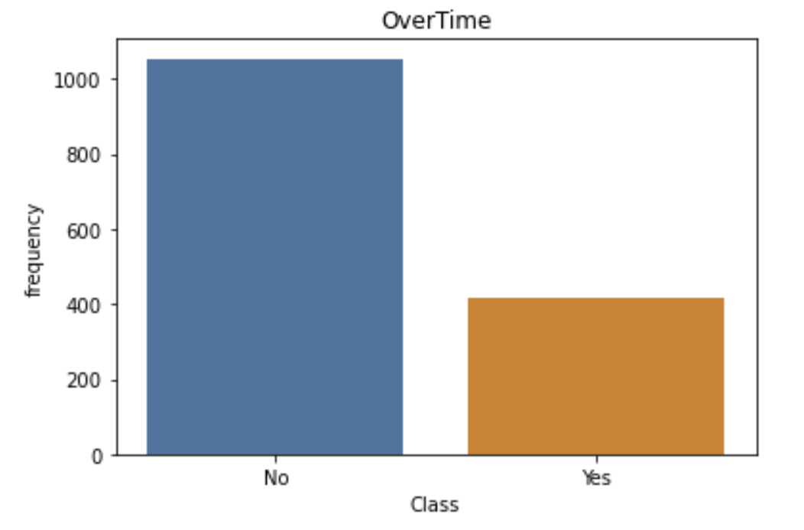
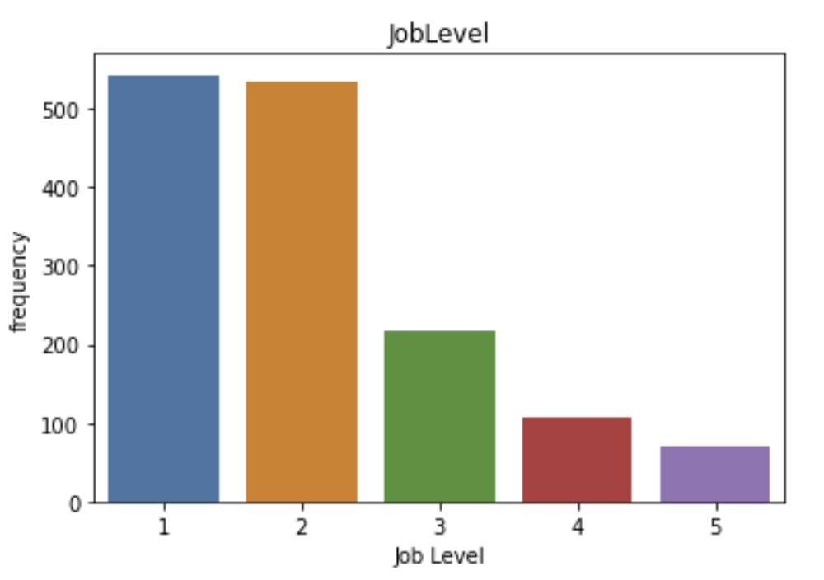
Business Understanding
Data Understanding
Data Preparation
Modeling
Evaluation
Deployment
Visualization of Attributes — Over Time, Stock Option Level, Job Level

Slide 9
Data
Preparation

Slide 10
Business Understanding
Data Understanding
Data Preparation
Modeling
Evaluation
Deployment
Drop Columns
Columns with static values and don’t add information on attrition
Ex: Employee Number, Over18, Department etc.
Collinear column that impact model performance
Ex. YearsWithCurrentManager
Feature Engineering
TotalSatisfaction = EnvironmentalSatisfaction + JobInvolvement + JobSatisfaction + RelationshipSatisfaction + WorkLifeBalance
Integrate Data to Proper Format for Data Mining
Change Variable Types
Switch numeric to categorical
Ex: Education, JobLevel etc.
Alter text to ordinal variable
Ex. BusinessTravel, assign “Non-Travel” to value 0, “Travel-Rarely” to 1, and “Travel-Frequently” to 2
Edit Imbalanced Target Variable Class
Resample to make attrition class 0 and 1 balanced
Make sure the prediction accuracy of the model that always predicts the majority class is ~ 50%

Slide 11
Modeling

Slide 12
Business Understanding
Data Understanding
Data Preparation
Modeling
Evaluation
Deployment
4
3
2
1
Visualization of the Tree Output the tree and display feature importance based on the tree model
Choose Decision Tree and Optimize the Model Cross validation, learning curve, parameter tuning
Train Data to Logistic Regression, k-NN and Decision Tree to Choose Best Model Fit null models and compare AUC score
Split and Normalize Data Split into 80% training and 20% testing data and make the output constant by assigning random seed; Standardize attributes

Slide 13
Business Understanding
Data Understanding
Data Preparation
Modeling
Evaluation
Deployment
Train Data to Logistic Regression, k-NN and Decision Tree to Choose Best Model
Based on ROC Graph and AUC Score, Decision Tree Outperformed LR and k-NN
It Makes Sense. WHY?
Logistic Regression
For smaller training-set sizes, logistic regression yields better generalization accuracy
k-NN
Curse of Dimensionality
Decision Tree
More flexible and robust to pick up complex relationships
With > 500 observations
Fit Null Model to Three Techniques:
LogisticRegression()
DecisionTreeClassifier()
KNeighborsClassifier()

Slide 14
Business Understanding
Data Understanding
Data Preparation
Modeling
Evaluation
Deployment
Choose Decision Tree and Optimize the Model Part 1
Learning Curve
Perform cross validation to get an idea of generalization performance
With 10 folds, the accuracy is 0.93 (+/- 0.02)
With 10 folds, the F1 Score is 0.93 (+/- 0.03)
2. Plot Learning Curve to narrow the parameter range
From the plot on the right, the “sweet spot” for ideal max_depth parameter of decision tree is around tree nodes 15

Slide 15
Business Understanding
Data Understanding
Data Preparation
Modeling
Evaluation
Deployment
Choose Decision Tree and Optimize the Model Part 2
Tuning parameters via grid search and nested cross-validation
Number of Tree Node (max_depth): 16
Splitting criterion: Gini
Splitter: Random
4. Validate the optimal model performance with Accuracy and AUC
Repeat step 3 necessarily to achieve higher accuracy of model’s generalization performance
Achieved Accuracy 0.947
AUC score 0.929 with 10-fold cross validation, making sure the good performance is true regularities and not just idiosyncrasies or sample anomalies

Slide 16
Business Understanding
Data Understanding
Data Preparation
Modeling
Evaluation
Deployment
Visualization of the Tree
Top Features Influencing Employee Attrition In the Company
OverTime
TotalSatisfaction
StockOptionLevel
TotalWorkingYears
JobLevel
……

Slide 17
Evaluation

Slide 18
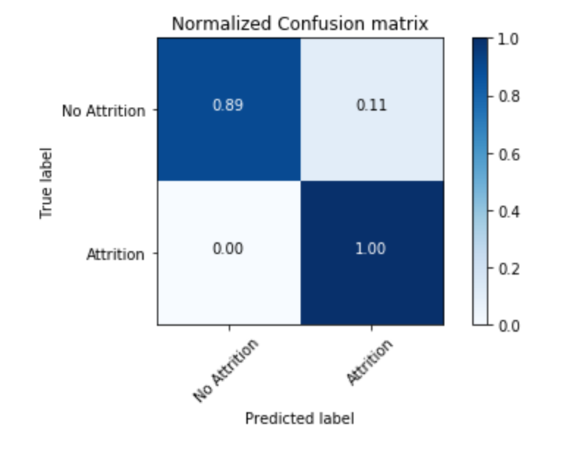
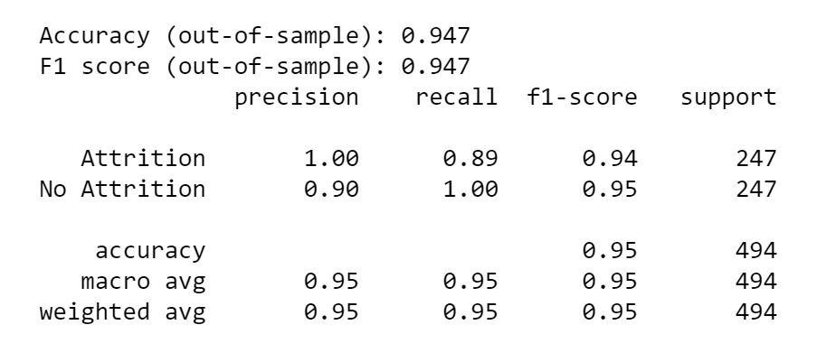
Business Understanding
Data Understanding
Data Preparation
Modeling
Evaluation
Deployment
Confusion Matrix

Slide 19
Business Understanding
Data Understanding
Data Preparation
Modeling
Evaluation
Deployment
ROC Curve

Slide 20
Deployment

Slide 21
Business Understanding
Data Understanding
Data Preparation
Modeling
Evaluation
Deployment
Focus on Employees A Company’s great asset, especially within the tech industry, technical talents are hard to find and retain. Hence, attrition problem is very important for tech companies
Flexible and Wide Application
Main Risk:
False Negatives
Flexible and Wide Application The decision tree model is applicable in various industries and companies where attrition is an issue
Identifying employees that are likely to leave can help minimize the costs associated with turnover
Ethical Considerations
Main Risk: False Negatives Failing to predict an employee’s departure could mean unintended performance drawbacks and time costs for a company
Focus on Employees
Potential Data Leakage
Ethical Considerations Keeping personal employee information confidential
Deployment
Potential Data Leakage Be aware that Job Satisfaction could be conducted after turnover, and it should not be included in the model when implementing

Slide 22
Q & A

Slide 23
Appendix
https://towardsdatascience.com/meaningful-metrics-cumulative-gains-and-lyft-charts-7aac02fc5c14
https://github.com/SydneyLauren/Profit-curves-and-xkcd-plotting
https://carmenlai.com/2016/11/12/user-churn-prediction-a-machine-learning-workflow.html
https://towardsdatascience.com/decision-tree-classifier-and-cost-computation-pruning-using-python-b93a0985ea77

Slide 24
Appendix
Variables in the Dataset (One Observation):
Age: 41 | Attrition: Yes | BusinessTravel: Travel_Rarely | DailyRate: 1102 | Department: Sales
DistanceFromHome: 1 | Education: 2 | EducationField: Life Sciences | EmployeeCount: 1 | EmpployeeNumber: 1
EnvironmentSatisfaction: 2 | Gender: Female | HourlyRate: 94 | JobInvolvement: 3 | JobLevel: 2
JobRole: Sales Executive | JobSatisfaction: 4 | MaritalStatus: Single | MonthlyIncome: 5993 | MonthlyRate: 19479
NumCompaniesWorked: 8 | Over18: Y | OverTime: Yes | PercentSalaryHike: 11 | PerformanceRating: 3
RelationshipSatisfaction: 1 | StandardHours: 80 | StockOptionLevel: 0 | TotalWorkingYears: 8 | TraniningTimesLastYear:0
WorkLifeBalance: 1 | YearsAtCompany:6 | YearsInCurrentRole: 4 | YearsSinceLastPromotion:0 | YearsWithCurrentManager: 5

Slide 25
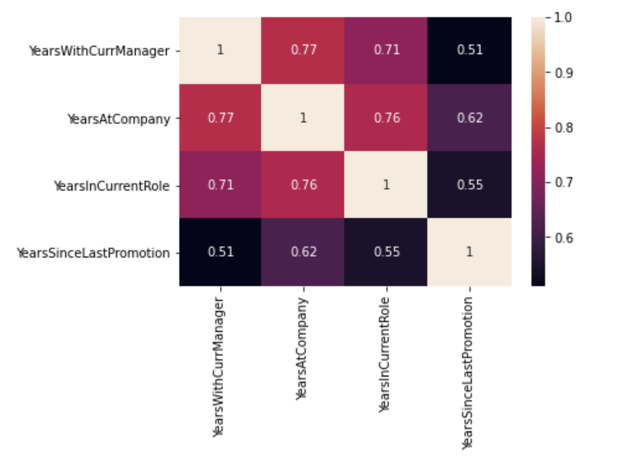
Appendix
Confusion Matrix with Multicollinear Columns
Code for Visualizing Important Features From the Tree

Slide 26
Thank You!

